Slide 1
globalemu: Novel and robust emulation of 21-cm signals from the Epoch of Reionization
Harry T. J. Bevins
Cavendish Asrophysics, University of Cambridge
In collaboration with Will Handley, Anastasia Fialkov, Eloy de Lera Acedo and Kamran Javid

Slide 2

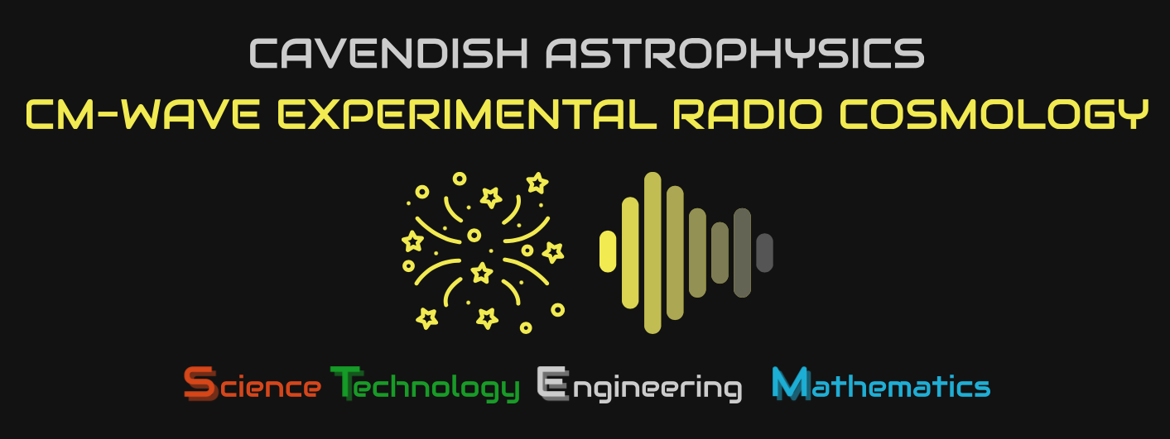
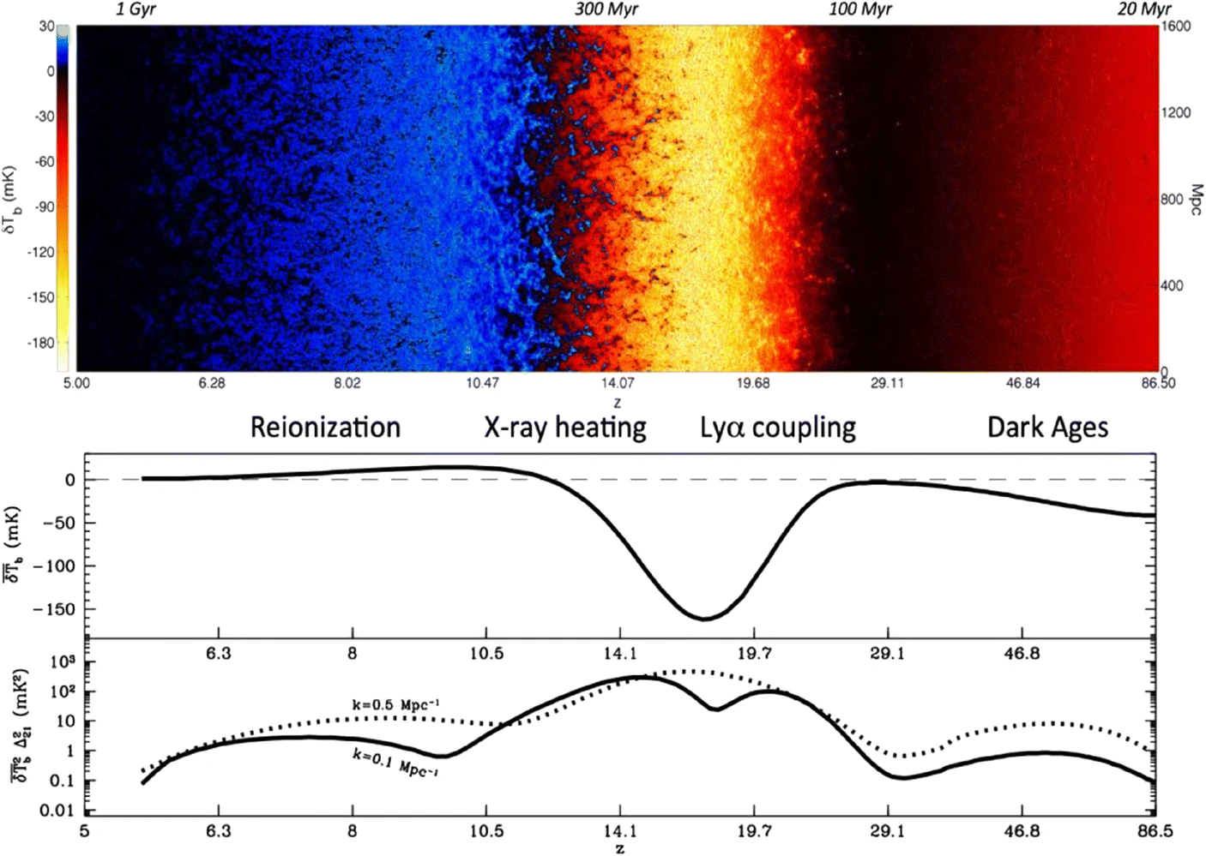
21-cm Cosmology and the SKA
REACH, EDGES, SARAS, LEDA etc.
SKA, HERA, MWA, LOFAR etc.
Koopmans, L.V.E., Barkana, R., Bentum, M. et al. Exp Astron 51, 1641–1676 (2021).
EAS Meeting Valencia 2022 – Harry Bevins (htjb2@cam.ac.uk)
Slide 2/12

Slide 3
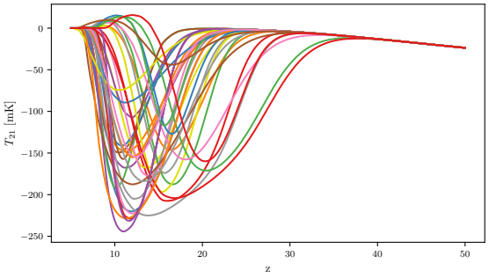
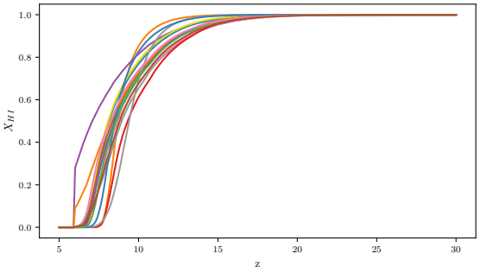
Why are we interested in signal emulators?
Need a quick method to generate physical signal models to fit to our data
Full semi numerical simulations take of order ~hrs
Neural network emulators produce signals ~ms
EAS Meeting Valencia 2022 – Harry Bevins (htjb2@cam.ac.uk)
Slide 3/12

Slide 4
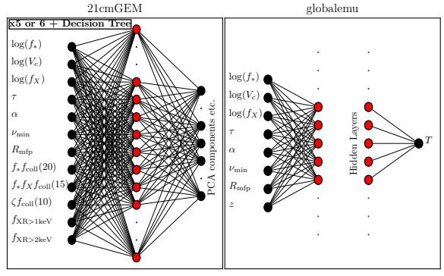
What is different about globalemu?
Redshift as an input
One simple and small neural network that we can make vectorised calls to
Train and test on the same dataset for comparison
EAS Meeting Valencia 2022 – Harry Bevins (htjb2@cam.ac.uk)
Slide 4/12

Slide 5
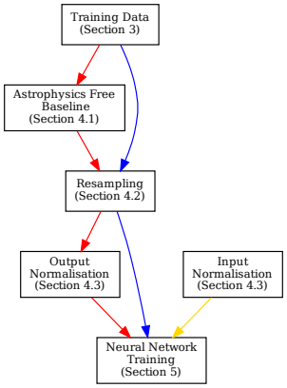
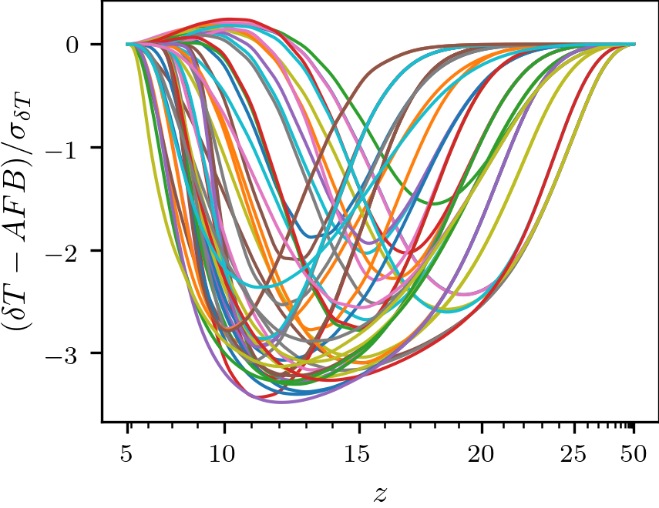
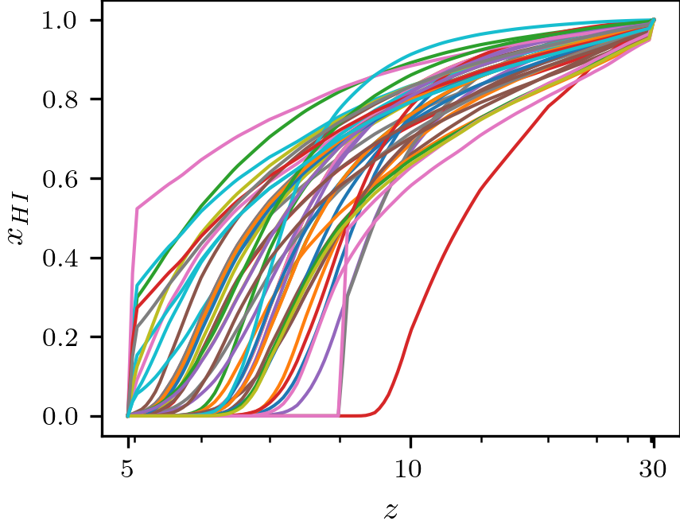
Physically Motivated Preprocessing
Lots of details in the paper
Subtract astrophysics free structure at high redshift and add it back in later
Resample signals to capture regions of high variation
EAS Meeting Valencia 2022 – Harry Bevins (htjb2@cam.ac.uk)
Slide 5/12

Slide 6
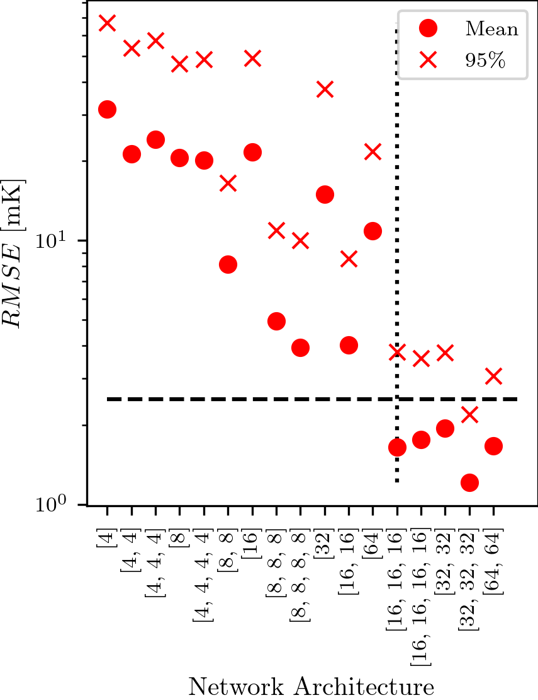

Neural Network Specifics
Practical decisions about our required accuracy based on the expected noise in the REACH experiment
Loss function and optimizer
EAS Meeting Valencia 2022 – Harry Bevins (htjb2@cam.ac.uk)
Slide 6/12

Slide 7
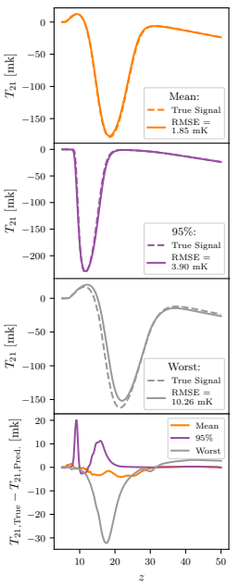
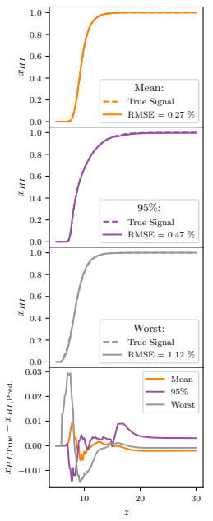
Results
For the global signal:
globalemu:
Max Normalised RMSE = 6.32 %
Emulation time: 1.3 ms
21cmGEM:
Max Normalised RMSE = 10.55 %
Emulation time: 133 ms
EAS Meeting Valencia 2022 – Harry Bevins (htjb2@cam.ac.uk)
Slide 7/12

Slide 8
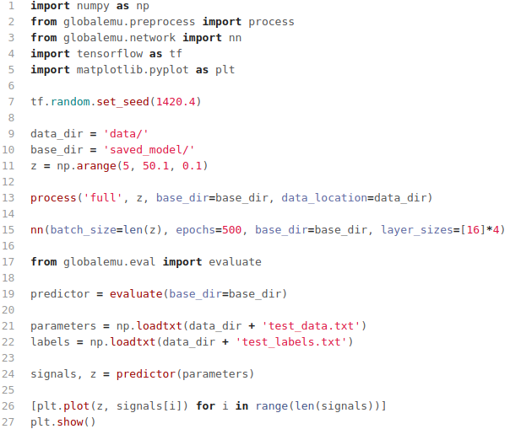
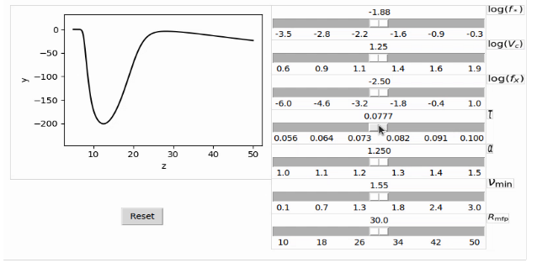
Accessible and Adaptable
Pip installable and fully documented
Available on github with some trained models
Emulator GUI
EAS Meeting Valencia 2022 – Harry Bevins (htjb2@cam.ac.uk)
Slide 8/12

Slide 9

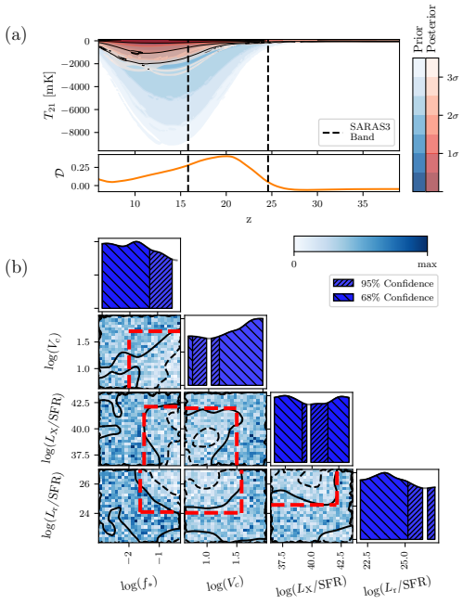
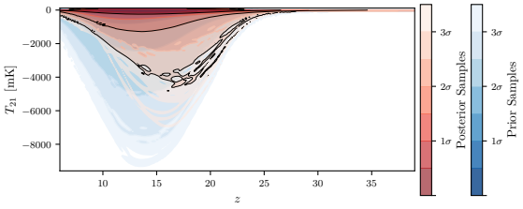
globalemu in action
SARAS2: https://doi.org/10.1093/mnras/stac1158
SARAS3: Submitted to Nature, Under Review
PRELIMINARY
Harry T. J. Bevins, Eloy de Lera Acedo, Anastasia Fialkov, Will J. Handley, Saurabh Singh, Ravi Subrahmanyan and Rennan Barkana
EAS Meeting Valencia 2022 – Harry Bevins (htjb2@cam.ac.uk)
Slide 9/12

Slide 10
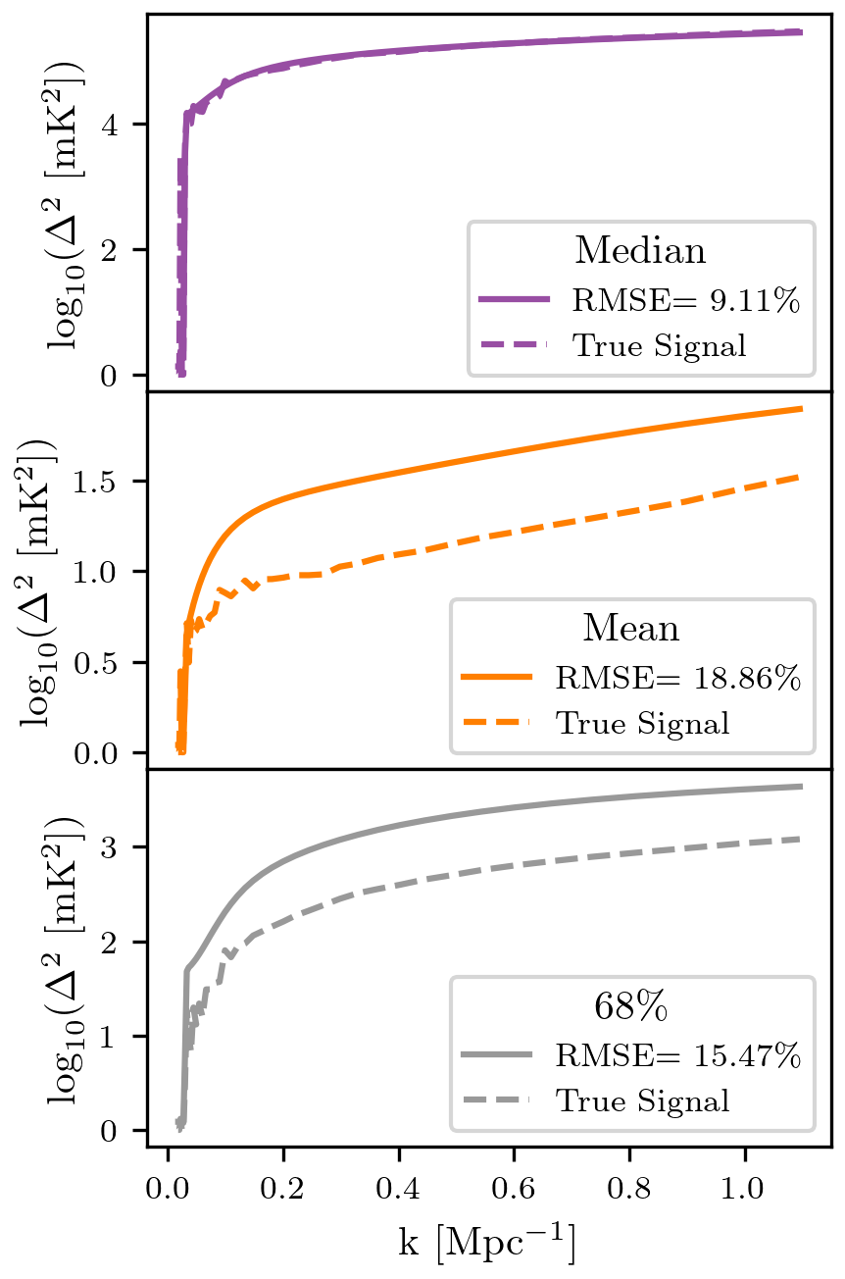
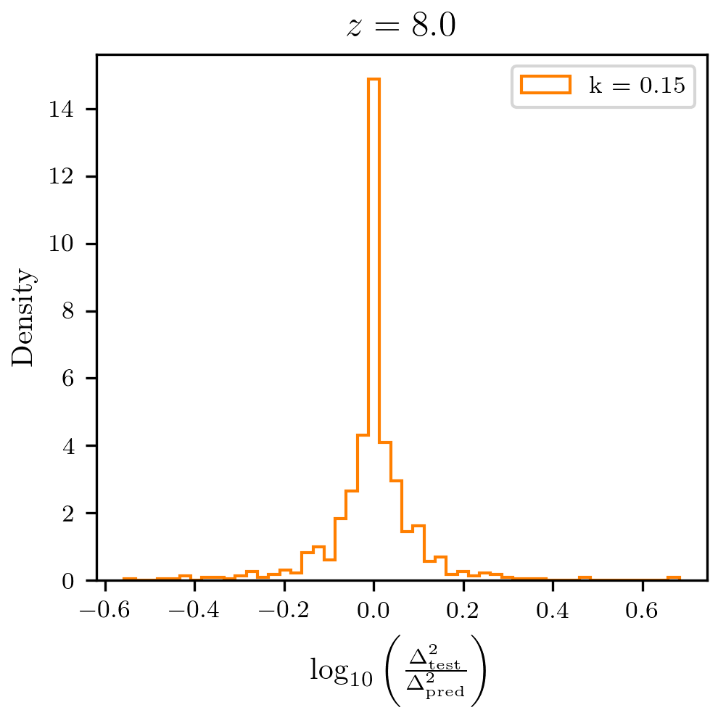
Not just a global signal emulator...
Training on some excess radio background power spectrum models and assessing at z=8 and k=0.15
Comparable accuracy to emulator used for recent HERA analysis (z=7.8, k=0.13)
EAS Meeting Valencia 2022 – Harry Bevins (htjb2@cam.ac.uk)
Slide 10/12

Slide 11
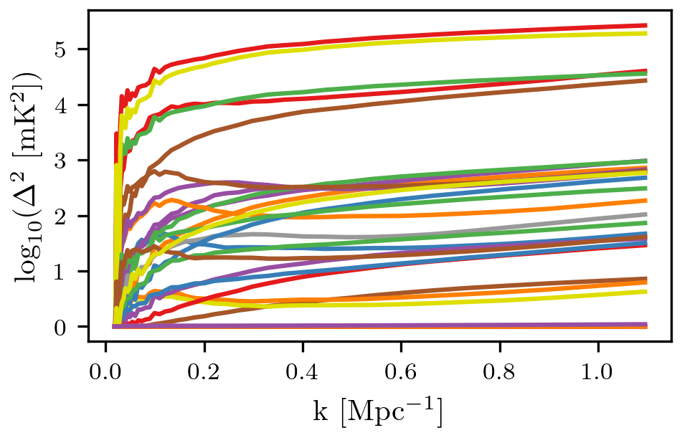
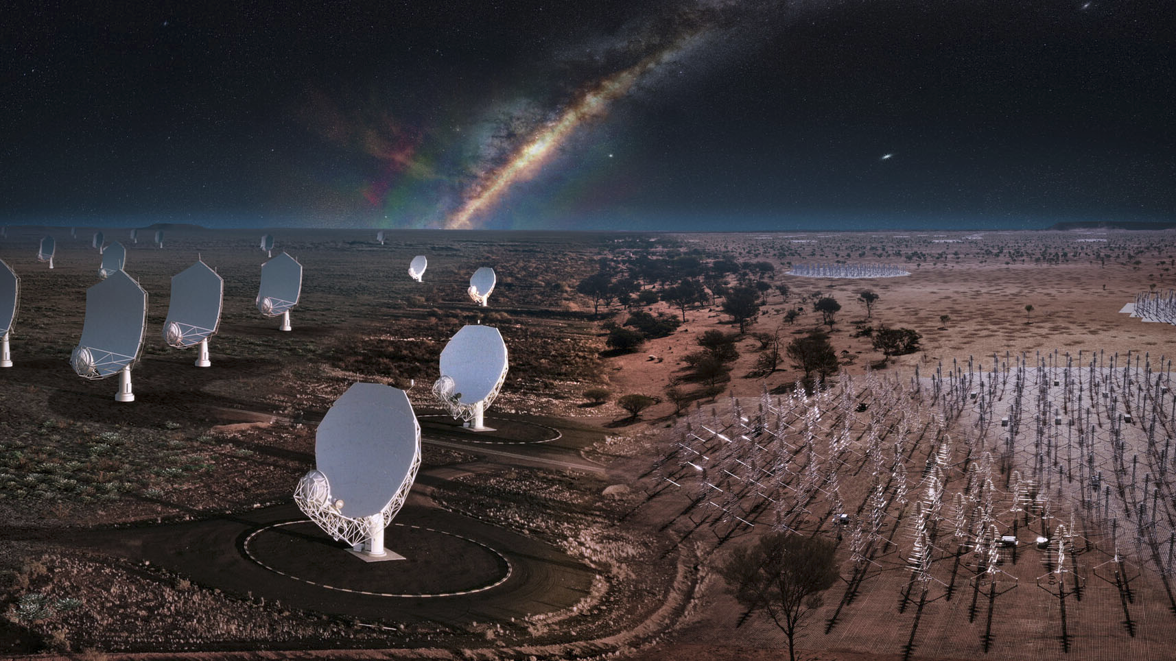
Why is this important for the SKA?
globalemu
EAS Meeting Valencia 2022 – Harry Bevins (htjb2@cam.ac.uk)
Slide 11/12

Slide 12
Conclusions
globalemu is your one stop shop for accurate and fast 21-cm signal emulation
For the global signal we see a factor of approximately two improvement in emulation accuracy and a factor of 102 improvement in emulation time
For the power spectrum we see a comparable level of accuracy with the emulator used in the recent HERA analysis
globalemu paper: https://doi.org/10.1093/mnras/stab2737
globalemu in action (fitting SARAS2 data): https://doi.org/10.1093/mnras/stac1158
github: https://github.com/htjb/globalemu
EAS Meeting Valencia 2022 – Harry Bevins (htjb2@cam.ac.uk)
Slide 12/12

